Slide 1
Background of
Deep Neural Networks

Slide 2


Slide Reference: Hardware Architectures for Deep Neural Networks
ISCA Tutorial
June 22, 2019
Website: http://eyeriss.mit.edu/tutorial.html
‹#›

Slide 3

Artificial Intelligence
Artificial Intelligence
“The science and engineering of creating intelligent machines”
- John McCarthy, 1956

Slide 4

AI and Machine Learning
Artificial Intelligence
Machine Learning
“Field of study that gives computers the ability to learn without being explicitly programmed”
– Arthur Samuel, 1959

Slide 5

Brain-Inspired Machine Learning
Artificial Intelligence
Machine Learning Brain-Inspired
An algorithm that takes its basic functionality from our understanding of how the brain operates

Slide 6
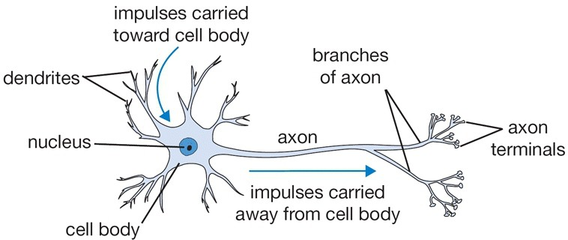
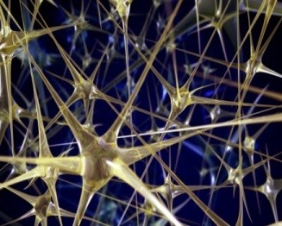
How Does the Brain Work?
The basic computational unit of the brain is a neuron
🡪 86B neurons in the brain
Neurons are connected with nearly 10¹⁴ – 10¹⁵ synapses
Neurons receive input signal from dendrites and produce output signal along axon, which interact with the dendrites of other neurons via synaptic weights
Synaptic weights – learnable & control influence strength
Image Source: Stanford
11

Slide 7

Spiking-based Machine Learning
Artificial Intelligence
Machine Learning Brain-Inspired
Spiking
12

Slide 8
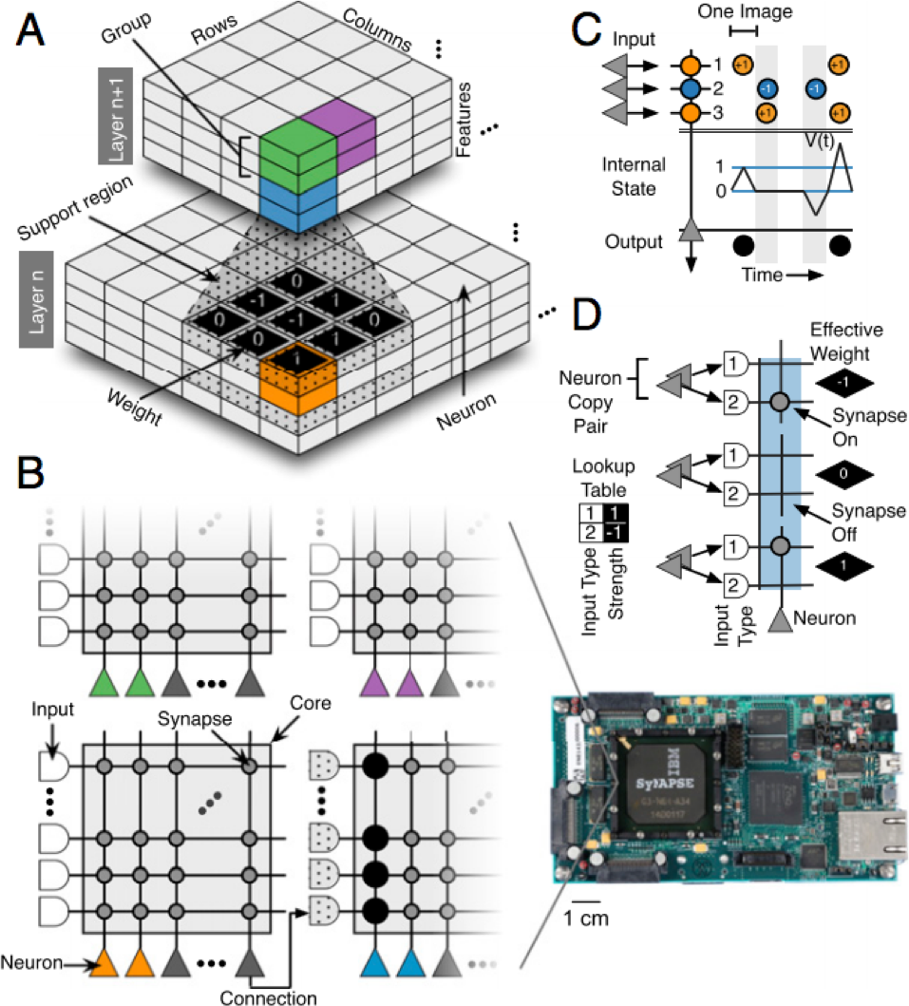
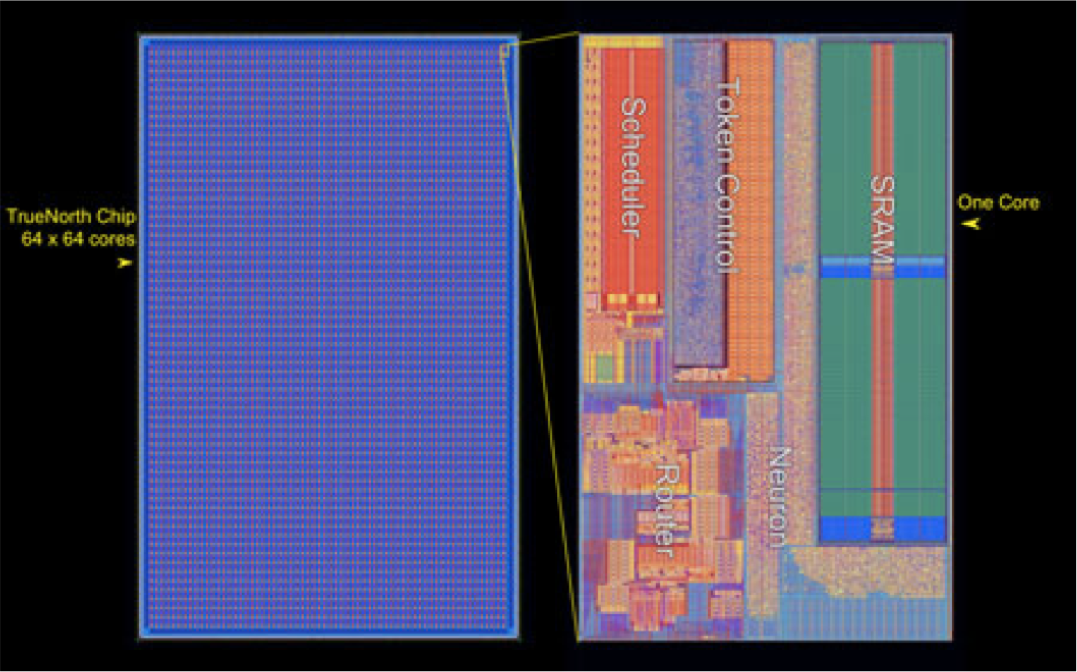
Spiking Architecture
Brain-inspired
Integrate and fire: Once a neuron reaches a certain potential, it spikes and resets its potential
Example: IBM TrueNorth
[Merolla et al., Science 2014; Esser et al., PNAS 2016] http://www.research.ibm.com/articles/brain-chip.shtml
13

Slide 9

Machine Learning with Neural Networks
Artificial Intelligence
Machine Learning Brain-Inspired
Spiking
Neural Networks
14

Slide 10
Overview of
Deep Neural Networks

Slide 11
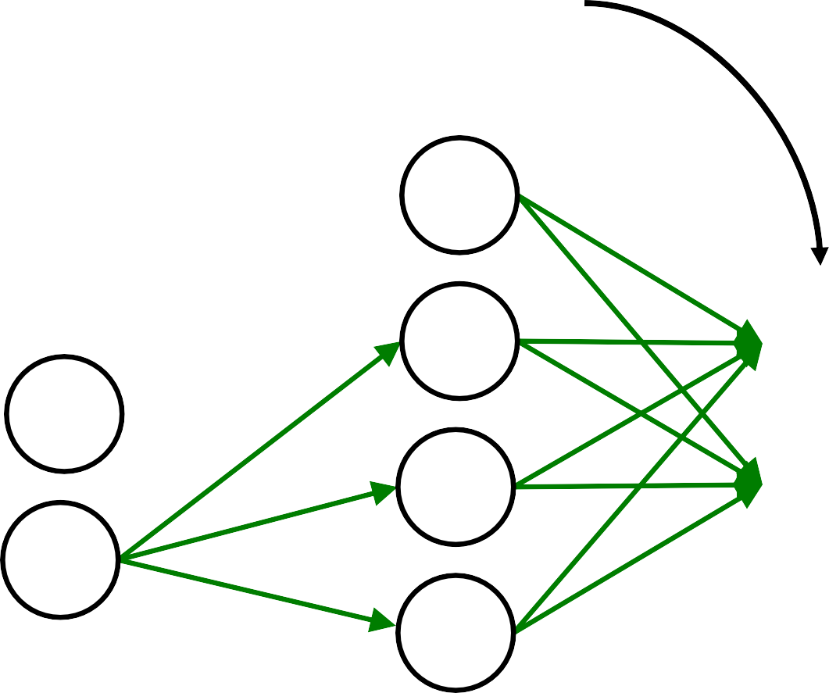

DNN Terminology 101
Neurons
Output Layer
Input Layer
Hidden Layer

Slide 12
DNN Terminology 101
Synapses
Output Layer
Input Layer
Hidden Layer

Slide 13
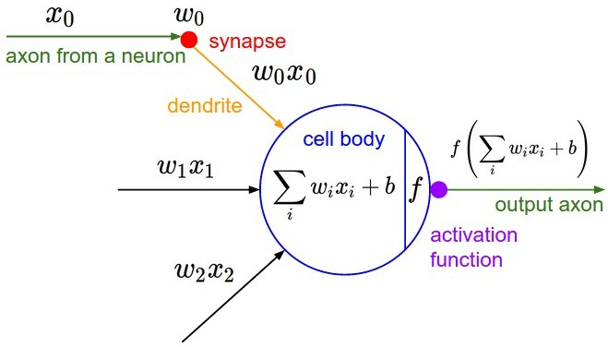
Neural Networks: Weighted Sum
A node, also called a neuron or Perceptron, is a computational unit that
has one or more weighted input connections, a transfer function that
combines the inputs in some way, and an output connection
Image Source: Stanford
15

Slide 14
Many Weighted Sums
Weights
Weights
Output Layer
Input Layer
Hidden Layer

Slide 15

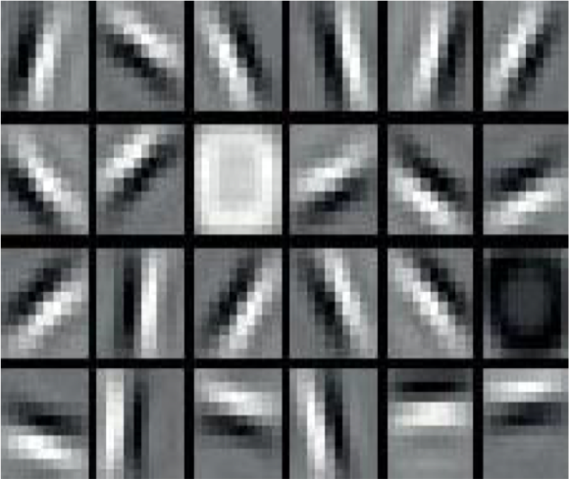
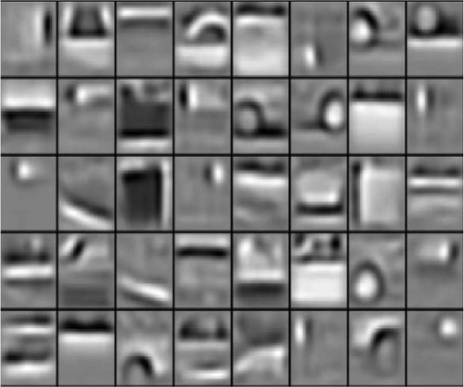
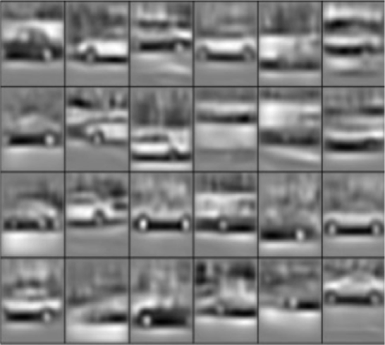
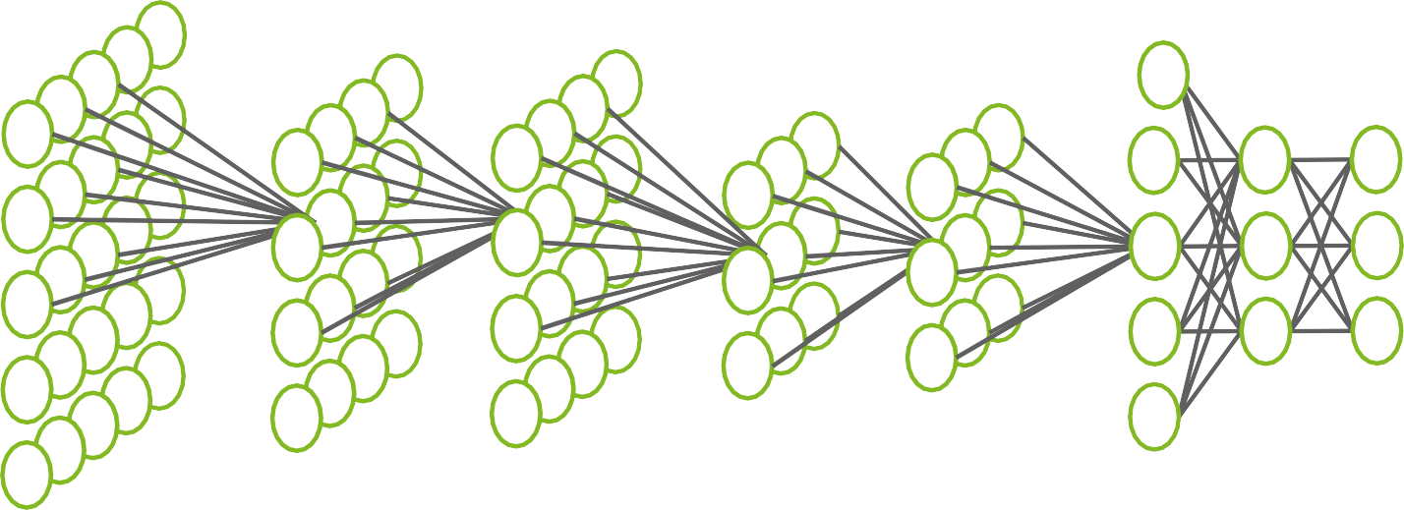
What is Deep Learning?
“Volvo XC90”
Image
Image Source: [Lee et al., Comm. ACM 2011]
18

Slide 16
DNN Terminology 101
Each synapse has a weight for neuron activation
⎛
3
⎞
X_{i ⎮}
⎠
Y_{j} = activation⎮∑W_{ij}
Y₁
⎛ i=1
^{W}11
X₁
Y₂
X₂
Y₃
X₃
^{W}34
Y₄
Output Layer
Input Layer
Hidden Layer
An activation function in a neural network defines
how the weighted sum of the input is transformed into an output from a node
or nodes in a layer of the network.

Slide 17
DNN Terminology 101
Weight Sharing: multiple synapses use the same weight value
⎛
3
⎞
X_{i ⎮}
⎠
Y_{j} = activation⎮∑W_{ij}
^{W}11
Y₁
⎛ i=1
X₁
Y₂
X₂
Y₃
X₃
^{W}34
Y₄
Output Layer
Input Layer
Hidden Layer

Slide 18
DNN Terminology 101
Layer 1
L1 Neuron outputs
a.k.a. Activations
L1 Neuron inputs
e.g. image pixels
Output Layer
Input Layer
Hidden Layer

Slide 19
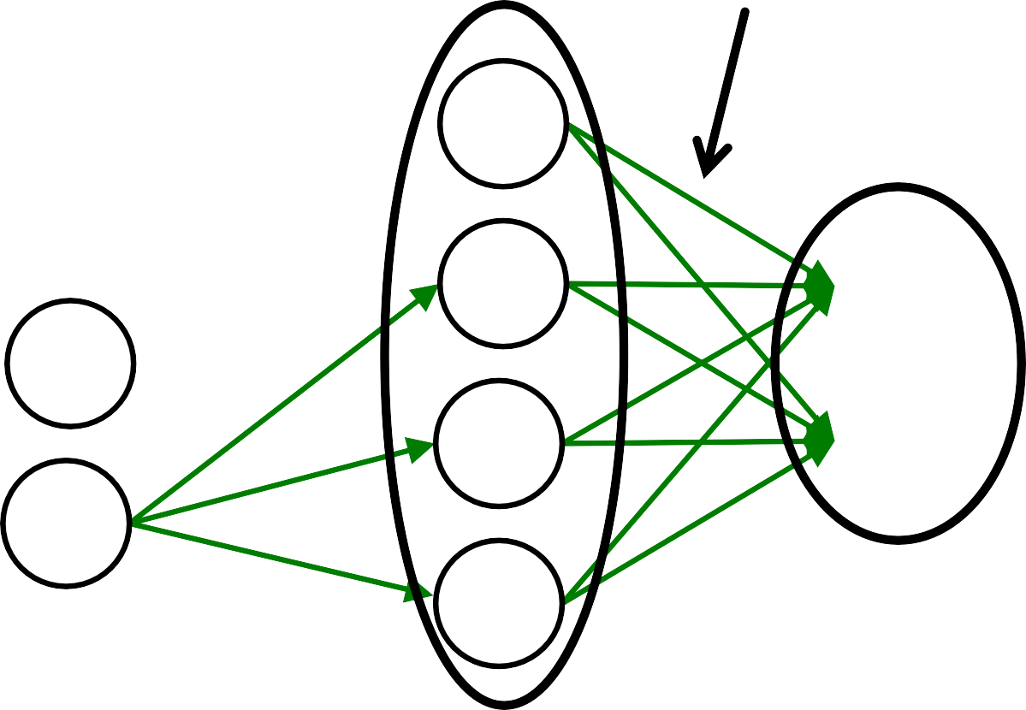
DNN Terminology 101
L2 Input Activations
Layer 2
L2 Output Activations
Output Layer
Input Layer
Hidden Layer

Slide 20
DNN Terminology 101
Fully-Connected: all i/p neurons connected to all o/p neurons
Sparsely-Connected
Output Layer
Input Layer
Hidden Layer

Slide 21
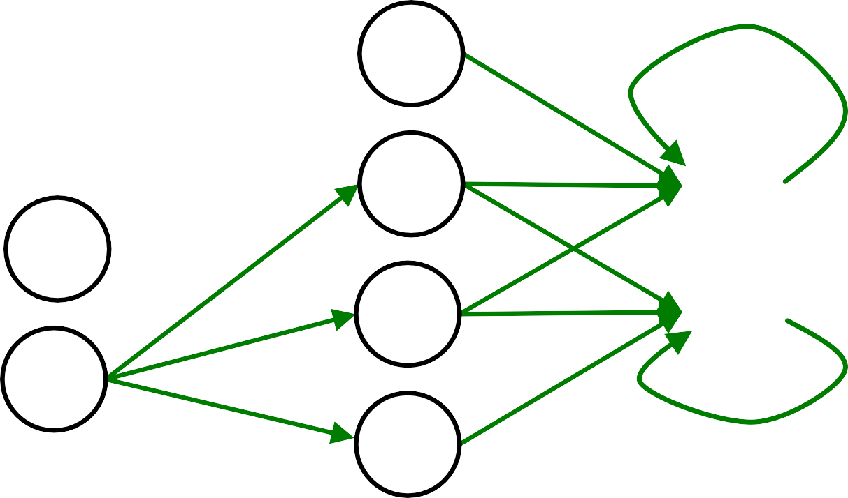
DNN Terminology 101
Feed Forward
Feedback
Output Layer
Input Layer
Hidden Layer

Slide 22
Popular Types of DNNs
Fully-Connected NN
feed forward, a.k.a. multilayer perceptron (MLP)
Convolutional NN (CNN)
feed forward, sparsely-connected w/ weight sharing
Recurrent NN (RNN)
feedback
Long Short-Term Memory (LSTM)
feedback + storage

Slide 23
Inference vs. Training
Training: Determine weights
Supervised:
Training set has inputs and outputs, i.e., labeled
Unsupervised / Self-Supervised:
Training set is unlabeled
Semi-supervised:
Training set is partially labeled
Reinforcement:
Output assessed via rewards and punishments
Inference: Apply weights to determine output

Slide 24



Deep Convolutional Neural Networks
Modern Deep CNN: 5 – 1000 Layers
Low-Level Features
High-Level Features
CONV
Layer
CONV
Layer
FC
Layer
…
Classes
1 – 3 Layers
The features are the elements of your input vectors.
The number of features is equal to the number of nodes in the input layer of the network.
Eg:to classify people as either men or women, the features would be things like height, weight, hair length etc.
Fully connected layers are global (they can introduce any kind of dependence). This is also why convolutions work so well in domains like image analysis - due to their local nature.

Slide 25


Convolution (CONV) Layer
a plane of input activations
a.k.a. input feature map (fmap)
filter (weights)
H
R
S
W
the input features can be concatenated into one large matrix.
Each row of this matrix contains all input values necessary to compute one
element of an output feature.
This process means that each input element will be replicated multiple times.

Slide 26

Convolution (CONV) Layer
input fmap
filter (weights)
H
R
S
W
Element-wise Multiplication
The feature map is the output of one filter applied to the previous layer.

Slide 27

Convolution (CONV) Layer
output fmap
an output
input fmap
filter (weights)
activation
H
R
E
S
W
F
Element-wise Multiplication
Partial Sum (psum)
Accumulation

Slide 28
Convolution (CONV) Layer
output fmap
an output
input fmap
filter (weights)
activation
H
R
E
S
W
F
Sliding Window Processing

Slide 29
Convolution (CONV) Layer
input fmap
filter
C
…
…
…
output fmap
C
…
…
…
H
…
R
E
…
…
S
W
F
Many Input Channels (C)

Slide 30
Convolution (CONV) Layer
input fmap
many filters (M)
output fmap
C
…
…
…
…
…
C
…
…
H
…
M
R
E
1
…
…
…
S
W
F
…
Many
Output Channels (M)
C
R
M
S
…
…
…
…

Slide 31
Convolution (CONV) Layer
Many Input fmaps (N)
Many Output fmaps (N)
filters
C
…
…
M
…
…
C
…
…
H
R
E
…
1
…
1
…
S
W
F
…
…
…
C
C
…
…
…
…
…
…
…
…
R
…
E
…
H
N
N
…
S
…
F
W

Slide 32
CNN Decoder Ring
N – Number of input fmaps/output fmaps (batch size)
C – Number of 2-D input fmaps /filters (channels)
H – Height of input fmap (activations)
W – Width of input fmap (activations)
R – Height of 2-D filter (weights)
S – Width of 2-D filter (weights)
M – Number of 2-D output fmaps (channels)
E – Height of output fmap (activations)
F – Width of output fmap (activations)

Slide 33
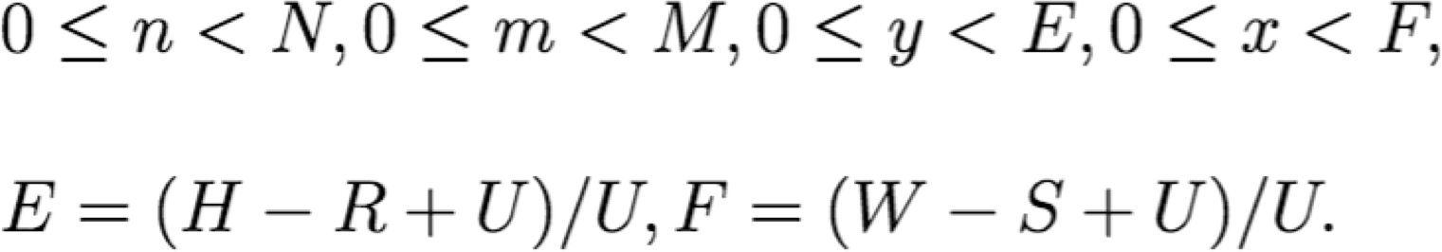
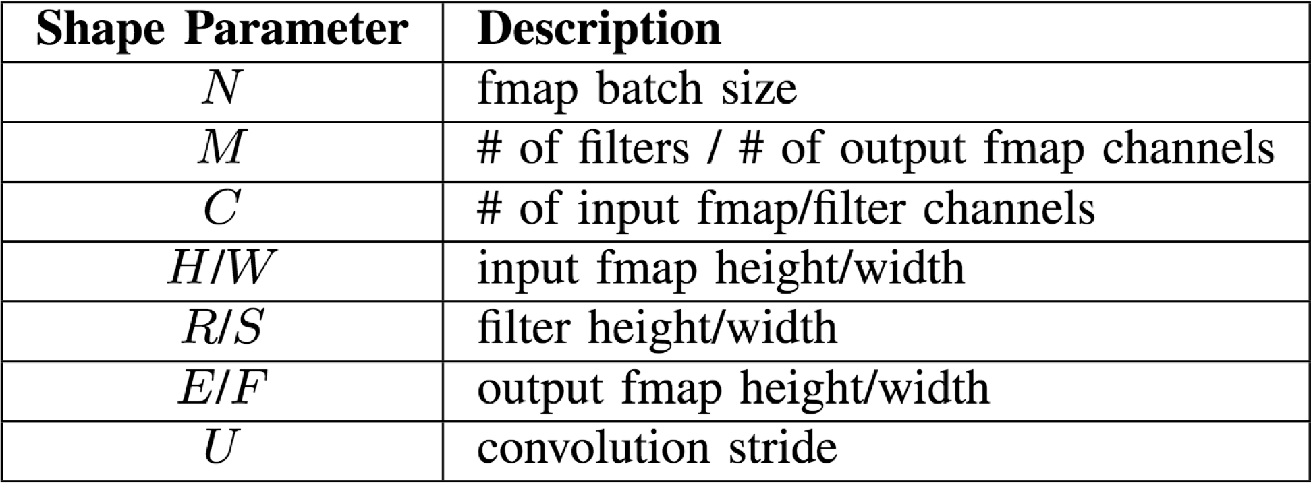
CONV Layer Tensor Computation
Output fmaps (O)
Biases (B)
Input fmaps (I)
Filter weights (W)

Slide 34
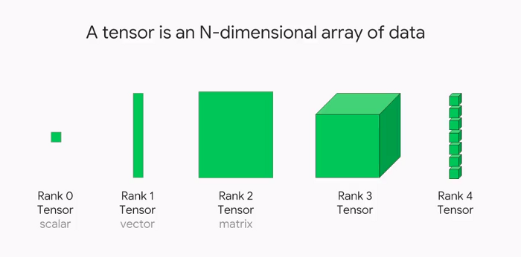
What is Tensor?
It is a container of Data, which helps to store different dimensions of Data in Neural Networks.
Google’s Machine Learning Library TensorFlow was named after them.
Vector Data: 2D tensors of shape (samples, features)
Time-Series Data or Sequence Data:
3D tensors of shape (samples, timesteps,features)
Images:
4D tensors of shape (samples, height, width, channels)
Videos:
5D tensors of shape (samples, frames, height, width, channels)

Slide 35
CONV Layer Tensor Computation
Output fmaps (O)
Biases (B)
Input fmaps (I)
Filter weights (W)

Slide 36
CONV Layer Implementation
Naïve 7-layer for-loop implementation:
for (n=0; n<N; n++) {
for (m=0; m<M; m++) {
for (x=0; x<F; x++) {
for (y=0; y<E; y++) {
for each output fmap value
O[n][m][x][y] = B[m];
for (i=0; i<R; i++) {
for (j=0; j<S; j++) {
for (k=0; k<C; k++) {
O[n][m][x][y] += I[n][k][Ux+i][Uy+j] × W[m][k][i][j];
}
}
}
convolve a window and apply activation
O[n][m][x][y] = Activation(O[n][m][x][y]);
}
}
}
}

Slide 37
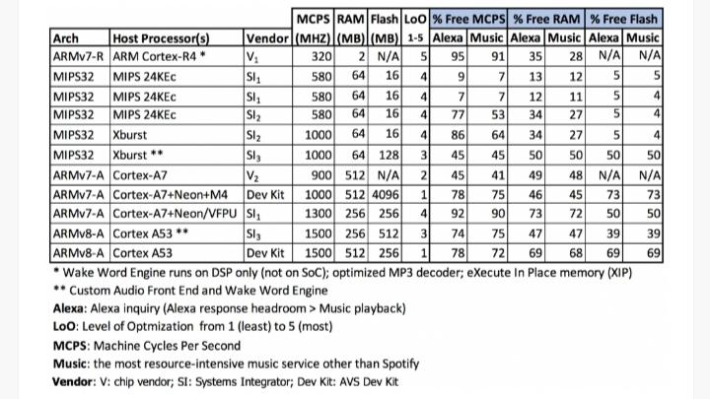
Embedded Scenario Facts
The Amazon Echo hardware complement includes a Texas Instruments DM3725 ARM Cortex-A8 processor, 256MB of LPDDR1 RAM and 4GB of storage space.
Maximum power can be reached in Amazon Alexa around 9W.
https://developer.amazon.com/blogs/alexa/post/2a32d792-d471-4136-8262-79962a2b4d72/cpu-memory-and-storage-for-alexa-built-in-devices
Ref:

Slide 38
Try The Following
TensorFlow is software framework to train and classify machine learning tasks. Tensorflow supports different APIs for Machine Learning based tasks.
It supports wide range of classification tasks: texts, images, videos, etc.
Open the tutorial: https://www.tensorflow.org/tutorials/images/classification
There are three options available:
Run in google Colab
View source on Github
Download the notebook
To check without any local setup choose first option: Run in google colab, you need to login with your google account.
The notebook explains how an artificial neural network trains on a flower dataset and after training it can classify new same class flowers.
Run the cells one by one to see a ML classification work in real time.

Slide 39
Deep Convolutional Neural Networks
Optional layers in between CONV and/or FC layers
High-Level Features
CONV
Layer
NORM
Layer
POOL
Layer
CONV
Layer
FC
Layer
Classes
Normalization
Pooling

Slide 40

Deep Convolutional Neural Networks
CONV
Layer
NORM
Layer
POOL
Layer
CONV
Layer
High-Level
^{Features} Classes
FC
Layer
Convolutions account for more than 90% of overall computation, dominating runtime and energy consumption

Slide 41
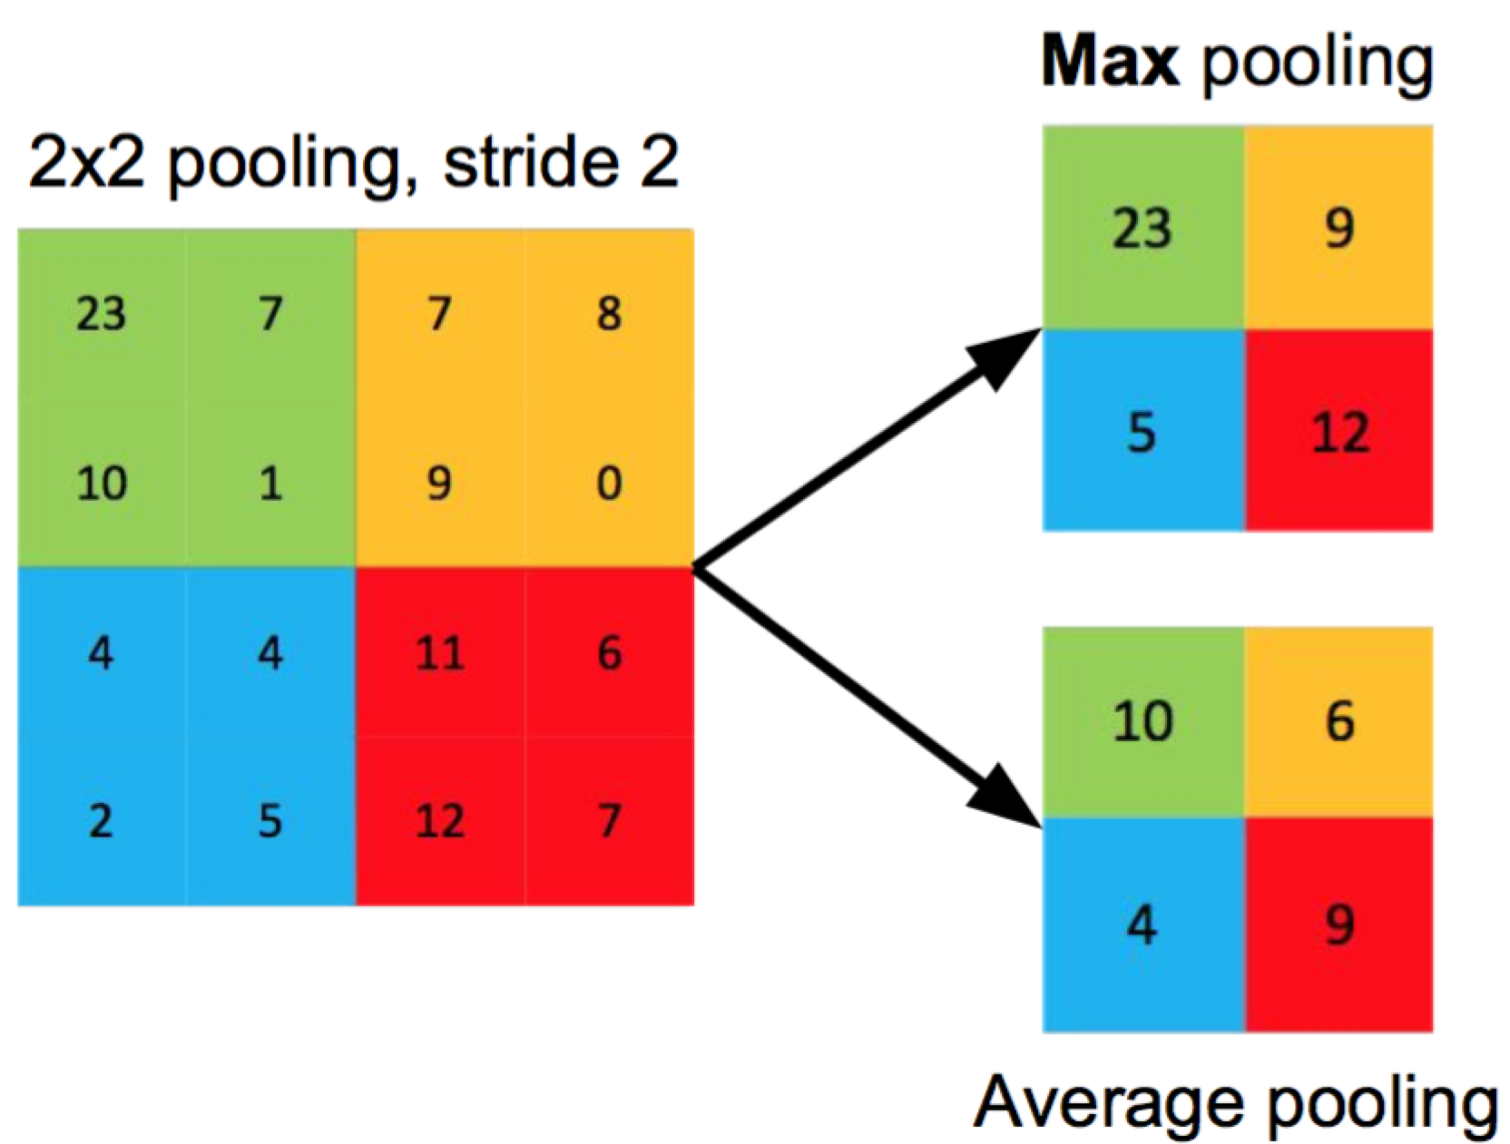
Pooling (POOL) Layer
Pooling layers are used to reduce the dimensions of the feature maps
Reduce resolution of each channel independently
Overlapping or non-overlapping 🡪 depending on stride
Increases translation-invariance and noise-resilience
Image Source: Caffe Tutorial
49

Slide 42
Pooling
A limitation of the feature map output of convolutional layers is that they record the precise position of features in the input. This means that small movements in the position of the feature in the input image will result in a different feature map. This can happen with re-cropping, rotation, shifting, and other minor changes to the input image.
A common approach to addressing this problem from signal processing is called down sampling. This is where a lower resolution version of an input signal is created that still contains the large or important structural elements, without the fine detail that may not be as useful to the task.
Down sampling can be achieved with convolutional layers by changing the stride of the convolution across the image.
A more robust and common approach is to use a pooling layer.
Translation invariance means that the system produces exactly the same response, regardless of how its input is shifted.

Slide 43
POOL Layer Implementation
Naïve 6-layer for-loop max-pooling implementation:
for (n=0; n<N; n++) {
for (m=0; m<M; m++) {
for (x=0; x<F; x++) {
for (y=0; y<E; y++) {
for each pooled value
max = -Inf;
for (i=0; i<R; i++) {
for (j=0; j<S; j++) {
if (I[n][m][Ux+i][Uy+j] > max) {
max = I[n][m][Ux+i][Uy+j];
}
}
}
find the max with in a window
O[n][m][x][y] = max;
}
}
}
}
50

Slide 44

Normalization (NORM) Layer
Batch Normalization (BN)
Normalize activations towards mean=0 and std. dev.=1 based on the statistics of the training dataset
put in between CONV/FC and Activation function
Convolution
BN
Activation
×
CONV
Layer
Believed to be key to getting high accuracy and faster training on very deep neural networks.
[Ioffe et al., ICML 2015]
51

Slide 45
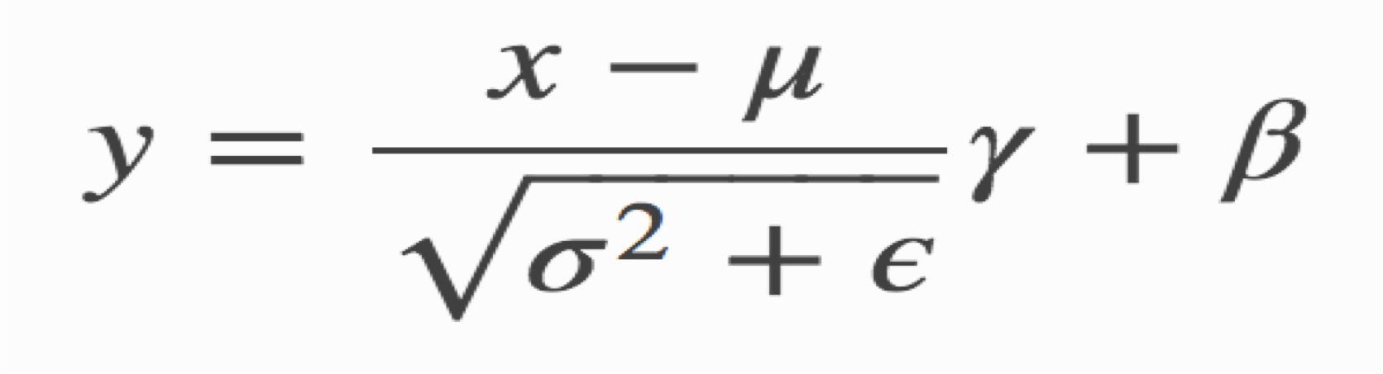
BN Layer Implementation
The normalized value is further scaled and shifted, the parameters of which are learned from training
data mean
learned scale factor
learned shift factor
small const. to avoid numerical problems
data std. dev.

Slide 46

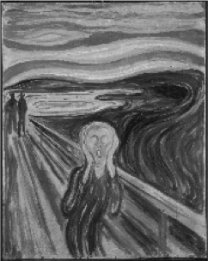
Deep Convolutional Neural Networks
Low-Level Features
High-Level Features
CONV
Layer
CONV
Layer
FC
Layer
…
Classes
Convolution
Activation
×

Slide 47
Deep Convolutional Neural Networks
Low-Level Features
High-Level Features
CONV
Layer
CONV
Layer
FC
Layer
…
Classes
Fully Connected
Activation
×

Slide 48
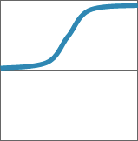
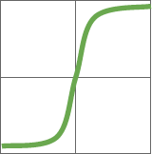
Traditional Activation Functions
Hyperbolic Tangent
1
Sigmoid
1
0
0
-1
-1
-1
-1 0 1
y=(e^{x}-e^{-x})/(e^{x}+e^{-x})
0
1
y=1/(1+e^{-x})
Image Source: Caffe Tutorial

Slide 49
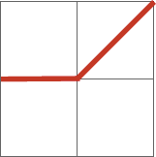

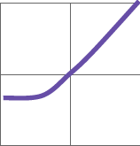
Modern Activation Functions
Rectified Linear Unit (ReLU)
Leaky ReLU
Exponential LU
1 |  |  | 1 |  |  | 1
0 |  |  | 0 |  |  | 0
-1 |  |  | -1 |  |  | -1
-1 | 0 | 1 | -1 | 0 | 1 | -1 | 0 | 1
x, x≥0
α(e^{x}-1),x<0
y=max(0,x)
y=max(αx,x) y=
α = small const. (e.g. 0.1)
Image Source: Caffe Tutorial

Slide 50
Activation Functions
The choice of activation function in the hidden layer will control how well the network model learns the training dataset. The choice of activation function in the output layer will define the type of predictions the model can make.
Sometimes the activation function is called a “transfer function.”
If the output range of the activation function is limited, then it may be called a “squashing function.”
Many activation functions are nonlinear and may be referred to as the “nonlinearity” in the layer or the network design.
The activation function is used within or after the internal processing of each node in the network, although networks are designed to use the same activation function for all nodes in a layer.

Slide 51
Activation Functions
A network may have three types of layers: input layers that take raw input from the domain, hidden layers that take input from another layer and pass output to another layer, and output layers that make a prediction.
All hidden layers typically use the same activation function.
The output layer will typically use a different activation function from the hidden layers and is dependent upon the type of prediction required by the model.
Activation functions are also typically differentiable, meaning the first-order derivative can be calculated for a given input value. This is required given that neural networks are typically trained using the backpropagation of error algorithm that requires the derivative of prediction error in order to update the weights of the model.

Slide 52
Activation for Hidden Layers
A hidden layer in a neural network is a layer that receives input from another layer (such as another hidden layer or an input layer) and provides output to another layer (such as another hidden layer or an output layer).
A neural network may have zero or more hidden layers.
Typically, a differentiable nonlinear activation function is used in the hidden layers of a neural network. This allows the model to learn more complex functions than a network trained using a linear activation function.:
ReLU Hidden Layer Activation Function
It is common because it is both simple to implement and effective at overcoming the limitations of other previously popular activation functions, such as Sigmoid and Tanh.
it is less susceptible to vanishing gradients that prevent deep models from being trained, although it can suffer from other problems like saturated or “dead” units.
The ReLU function is calculated as follows:
max(0.0, x)
This means that if the input value (x) is negative, then a value 0.0 is returned, otherwise, the value is returned.

Slide 53
Output Activation Functions
Linear Output Activation Function
The linear activation function is also called “identity” (multiplied by 1.0) or “no activation.”
This is because the linear activation function does not change the weighted sum of the input in any way and instead returns the value directly.
Sigmoid Output Activation Function
Target labels used to train a model with a sigmoid activation function in the output layer will have the values 0 or 1.
Softmax Output Activation Function
The softmax function outputs a vector of values that sum to 1.0 that can be interpreted as probabilities of class membership.
As such, the input to the function is a vector of real values and the output is a vector of the same length with values that sum to 1.0 like probabilities.

Slide 54
FC Layer – from CONV Layer POV
filters input fmaps output fmaps
C
C
…
…
…
…
…
…
H
H
…
1
1
…
1
…
1
…
1
W
W
…
C
C
…
…
…
…
…
…
…
H
…
1
H
N
…
M
…
N
…
1
W
W

Slide 55
Fully-Connected (FC) Layer
Height and width of output fmaps are 1 (E = F = 1)
Filters as large as input fmaps (R = H, S = W)
Implementation: Matrix Multiplication
Filters
CHW
Input fmaps
N
Output fmaps
N
CHW
×
=
M
M

Slide 56
Deep architectures often advantageous when dealing with complex learning problems.
The stacking of multiple linear and non-linear processing units in a layer-wise fashion provides the ability to learn complex representations at different levels of abstraction.
The availability of big data and advancements in hardware are also the main reasons for the recent success of deep CNNs.

